Slide 1
Why does my yelp rating suck?
Or, the influence of external factors on yelp restaurant ratings.
By kadar Amek, Michael Bodamer, Carolyn Tsai

Slide 2
MotivatioN
Yelp ratings are important to restaurateurs- A few points can make the difference between a customer deciding to go to the restaurant and choosing to eat somewhere else
But some factors are outside of an owners control: things like that might affect a customers experience, and therefore their yelp review.
We wanted to know if external factors beyond an owners control have any impact or correlation with yelp reviews.

Slide 3
Defining our scope
First, we needed to pick some external factors that we thought might have an impact on yelp reviews:
Crime rates
Parking citations
Income levels
All these things are be beyond a restaurateurs control, and all of them could negatively impact a customers experience.

Slide 4
Defining our Scope
We also needed to figure out how expansive we were going to make our study: Should we look at yelp reviews and crime in the world? The US? Major cities only?
We decided to only look at yelp reviews in Los Angeles.
Los Angeles is a big enough city to have many distinct districts- giving us a chance to find more significant differences (and hopefully results) between them
Los Angeles also has a really nice data repository online that we can pull from.
Yelp only allows a certain number of API calls.

Slide 5
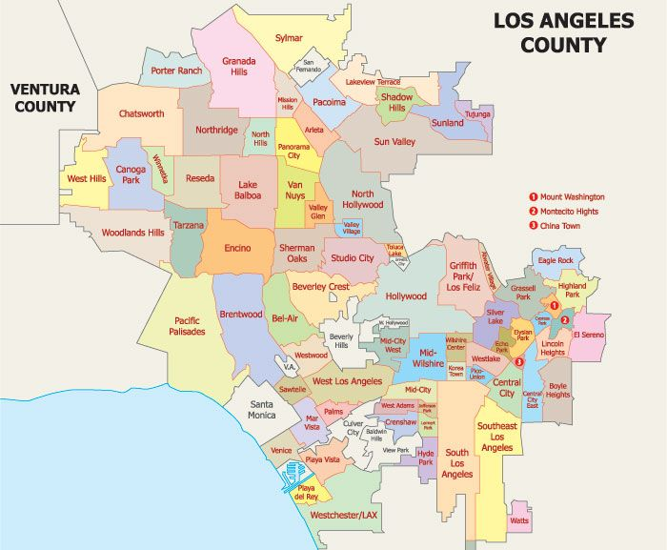

Slide 6


Pulling the Data
Sources
Data.lacity.gov Datasets
Google Geocoding API
Citipy Library
Yelp Fusion API

Slide 7
Data Cleanup & Exploration: Clearing the chaff
Naturally, as we explored our data, there was a lot of columns that were junk to us
Name of the restaurant, crime ID, and report number were all dropped from the final datasets.
Date and time were also dropped, but not before we used them to make sure we were only getting 2018 data.

Slide 8
Data Cleanup & Exploration: The Redistricting
Unfortunately, neither the LA data that we pulled or the yelp data was sorted by district- So our first order of business was to sort our yelp, crime, and citation data by district.
Fortunately, you can do this through the google geocoding API.
Unfortunately, we had ~1.3million rows of data all together, and the google API is not free
Total cost would’ve been around $17,000.

Slide 9
Data Cleanup & Exploration: The Redistricting
Our initial solution was to limit the number of API calls by taking a smaller, random selection of our data and using that instead.
Fortunately, we found that the free citipy library actually allows you to find districts for free, albeit in a different way.
Essentially, the districts we created approximate the real districts, but not exactly.
This way, we were able to use all of our data.

Slide 10
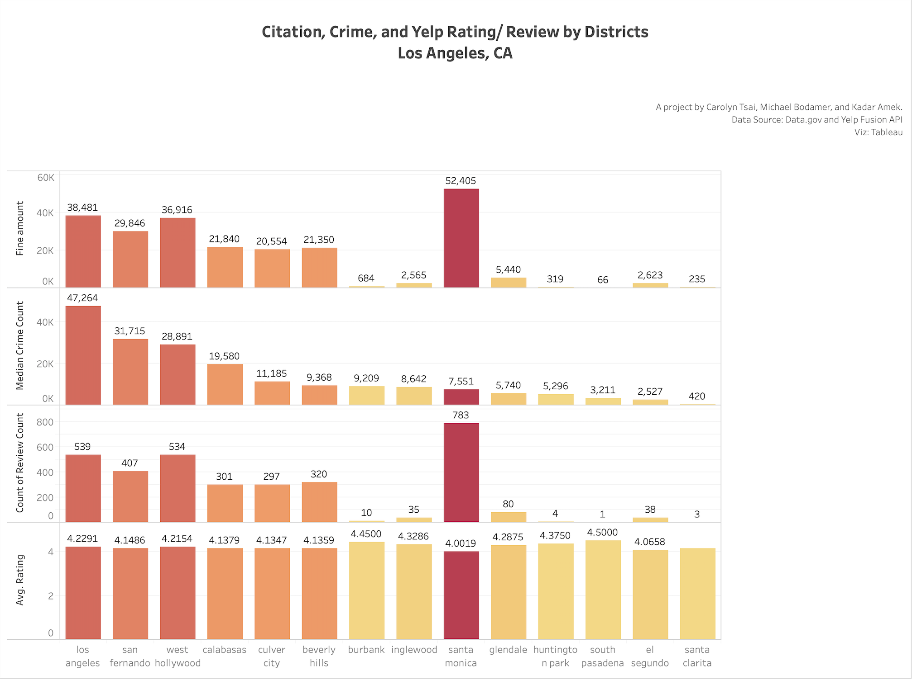
Initial Findings

Slide 11
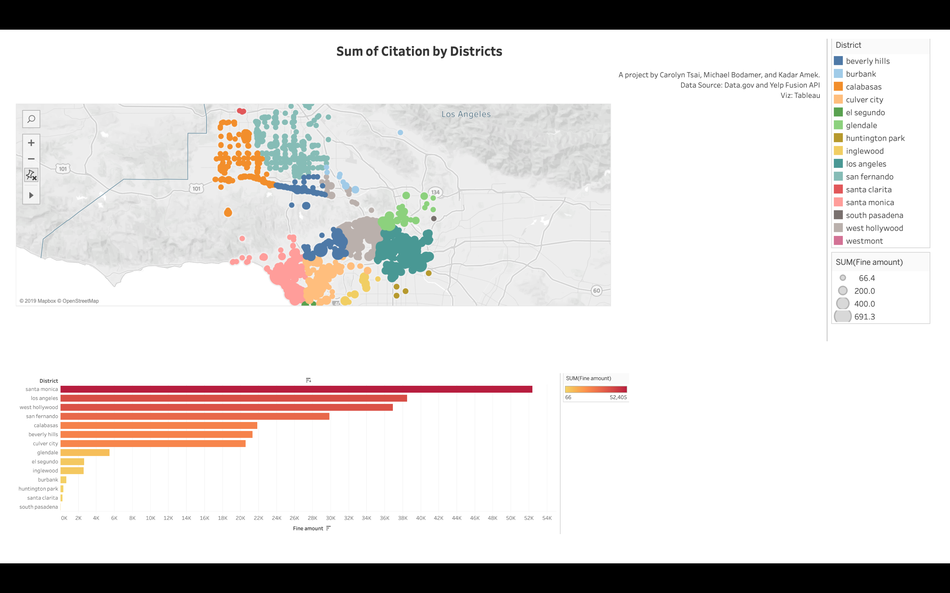

Slide 12
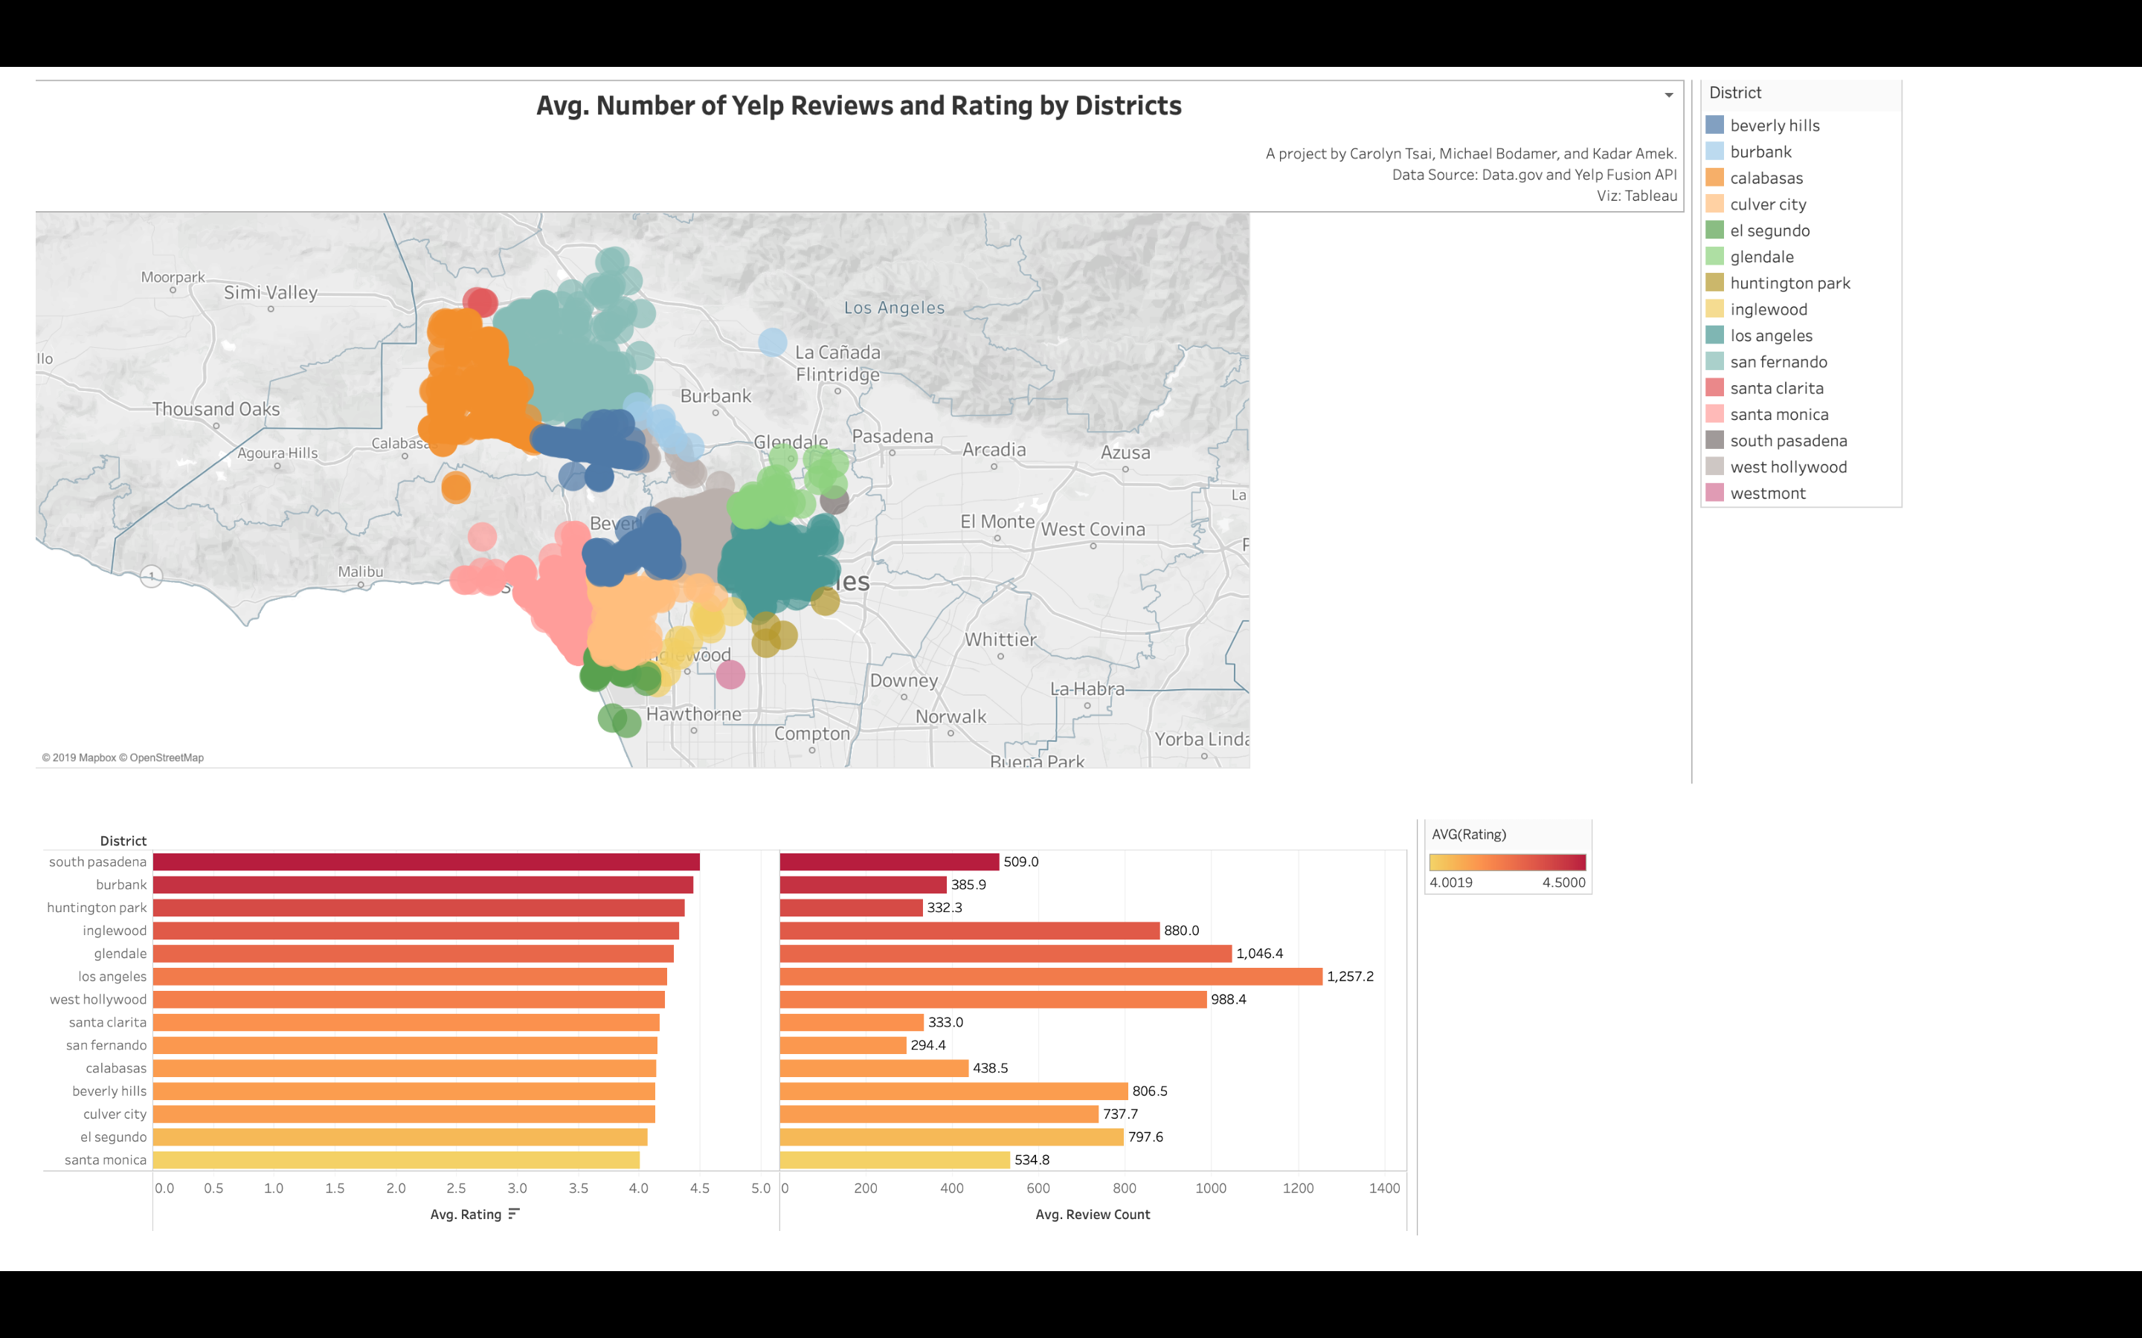

Slide 13
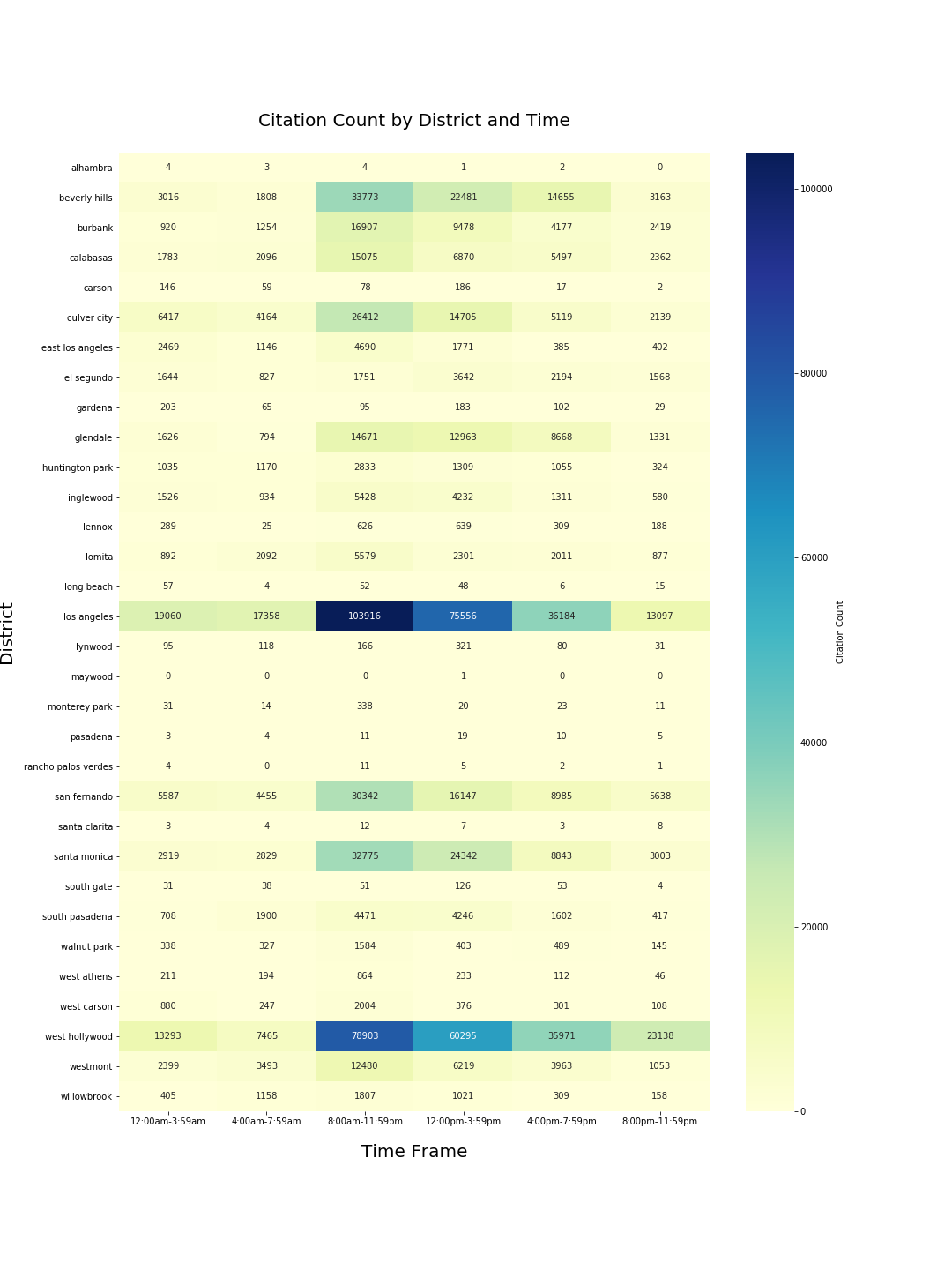
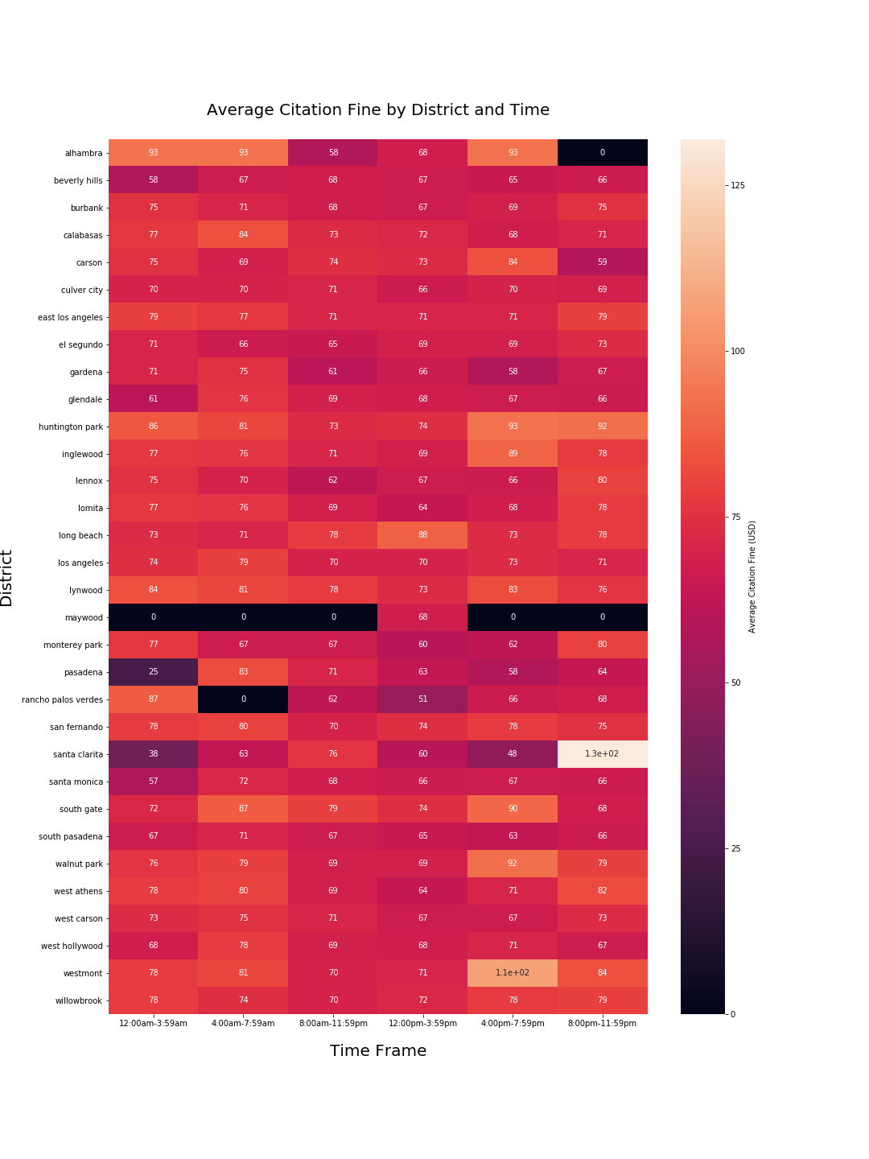

Slide 14
Data Analysis

Slide 15
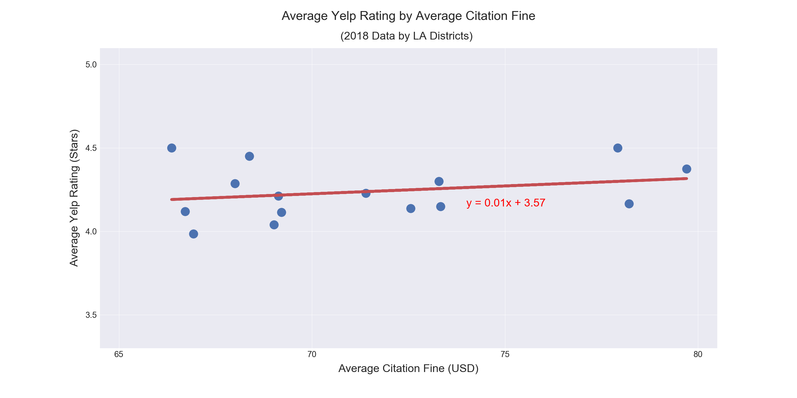
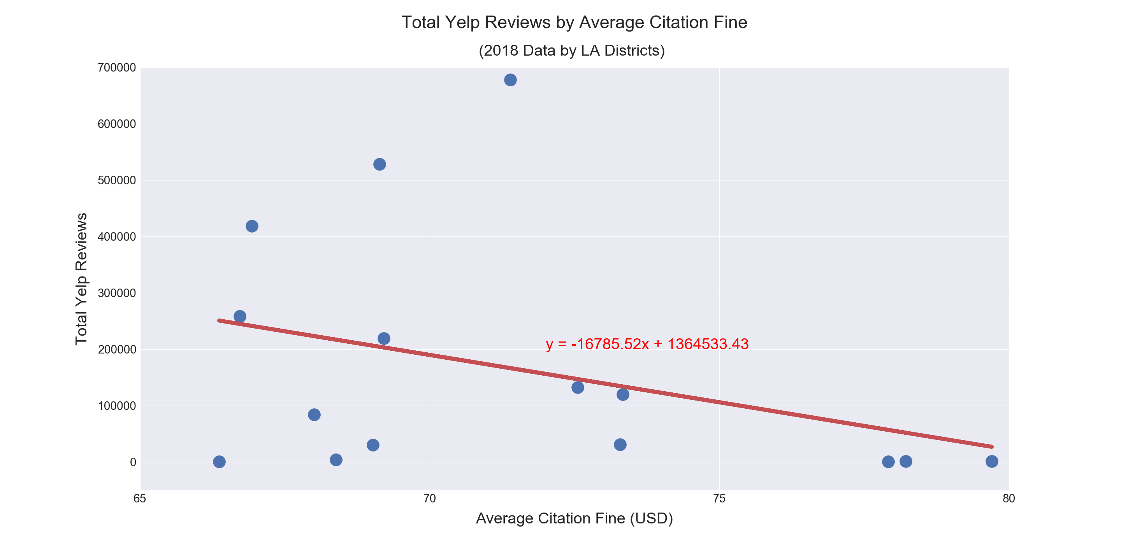

Slide 16
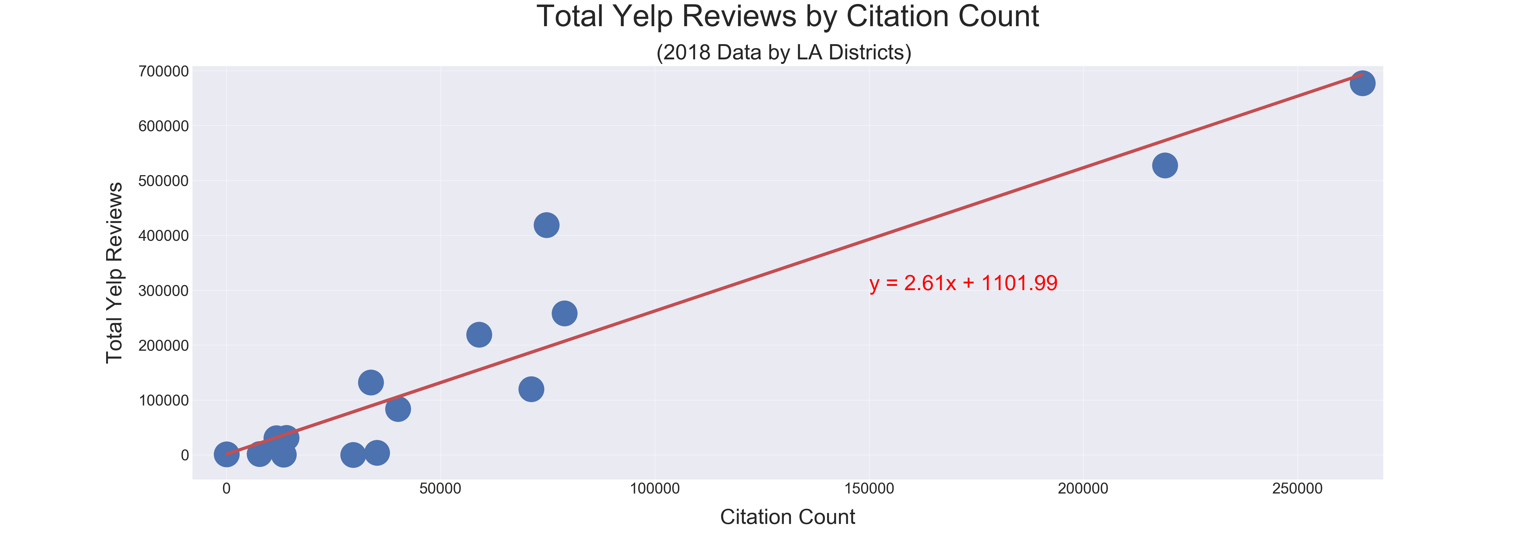
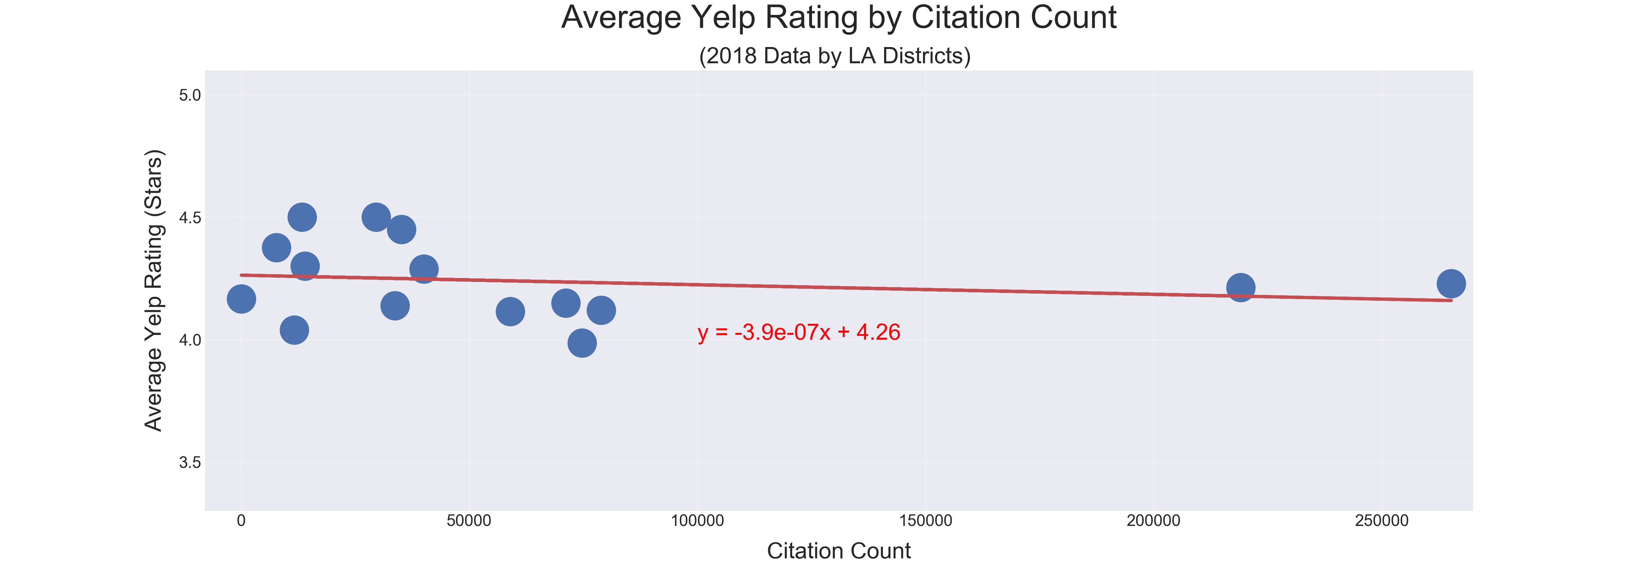

Slide 17
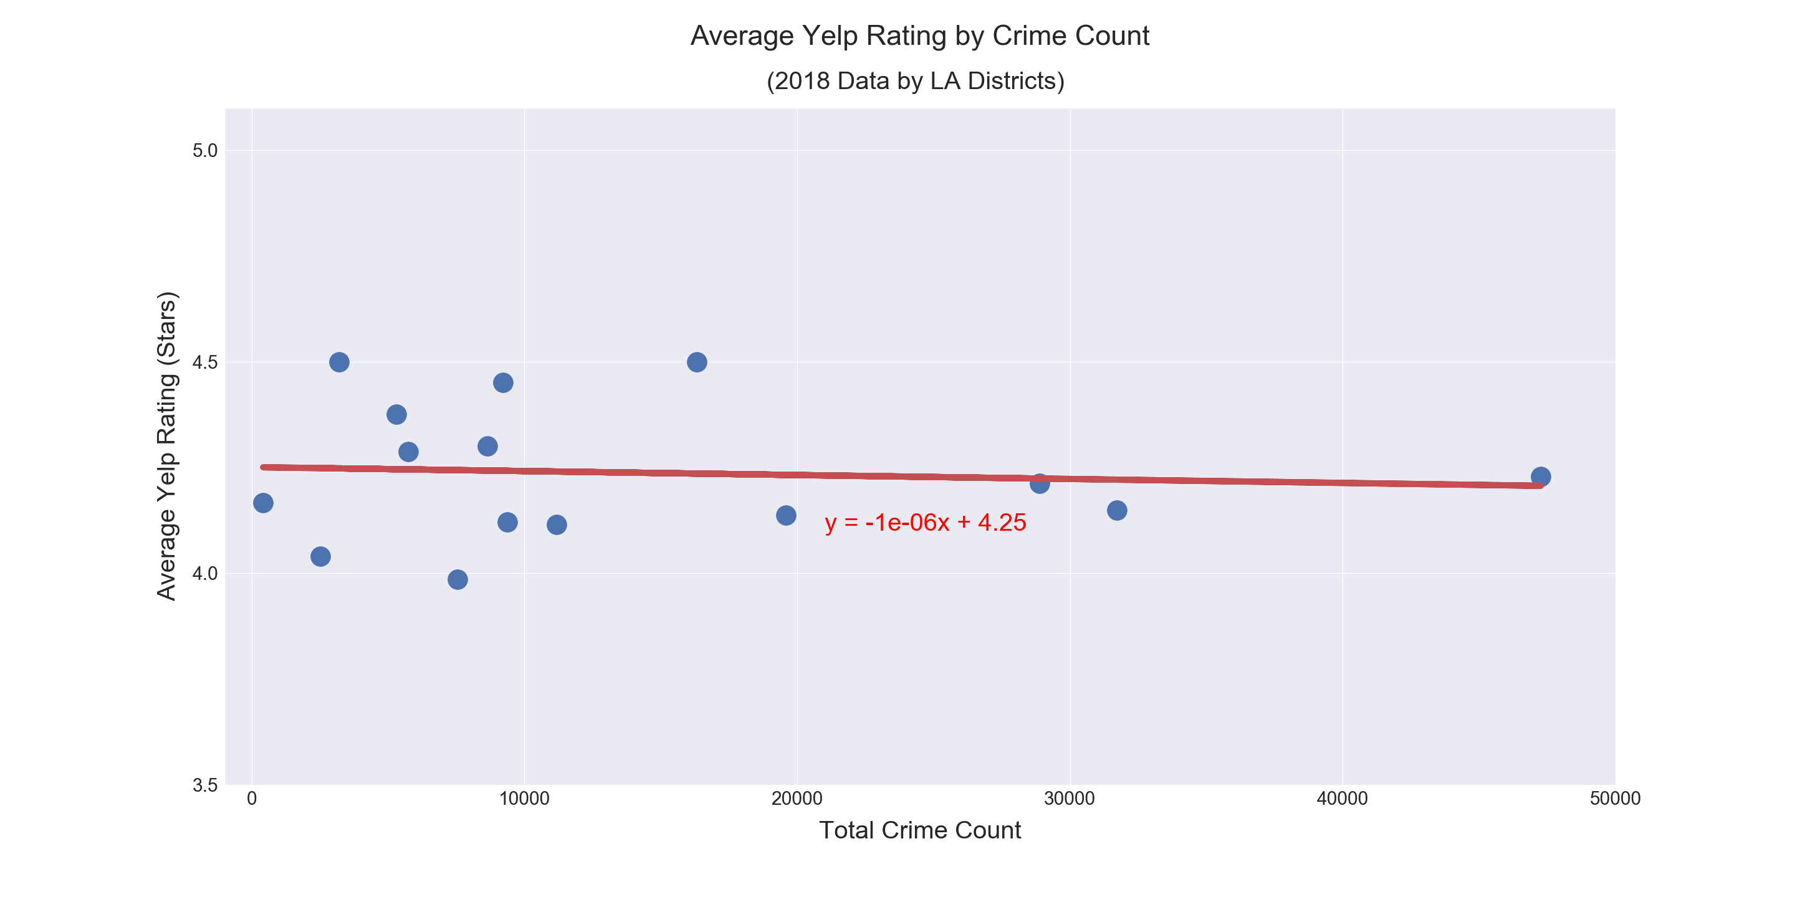
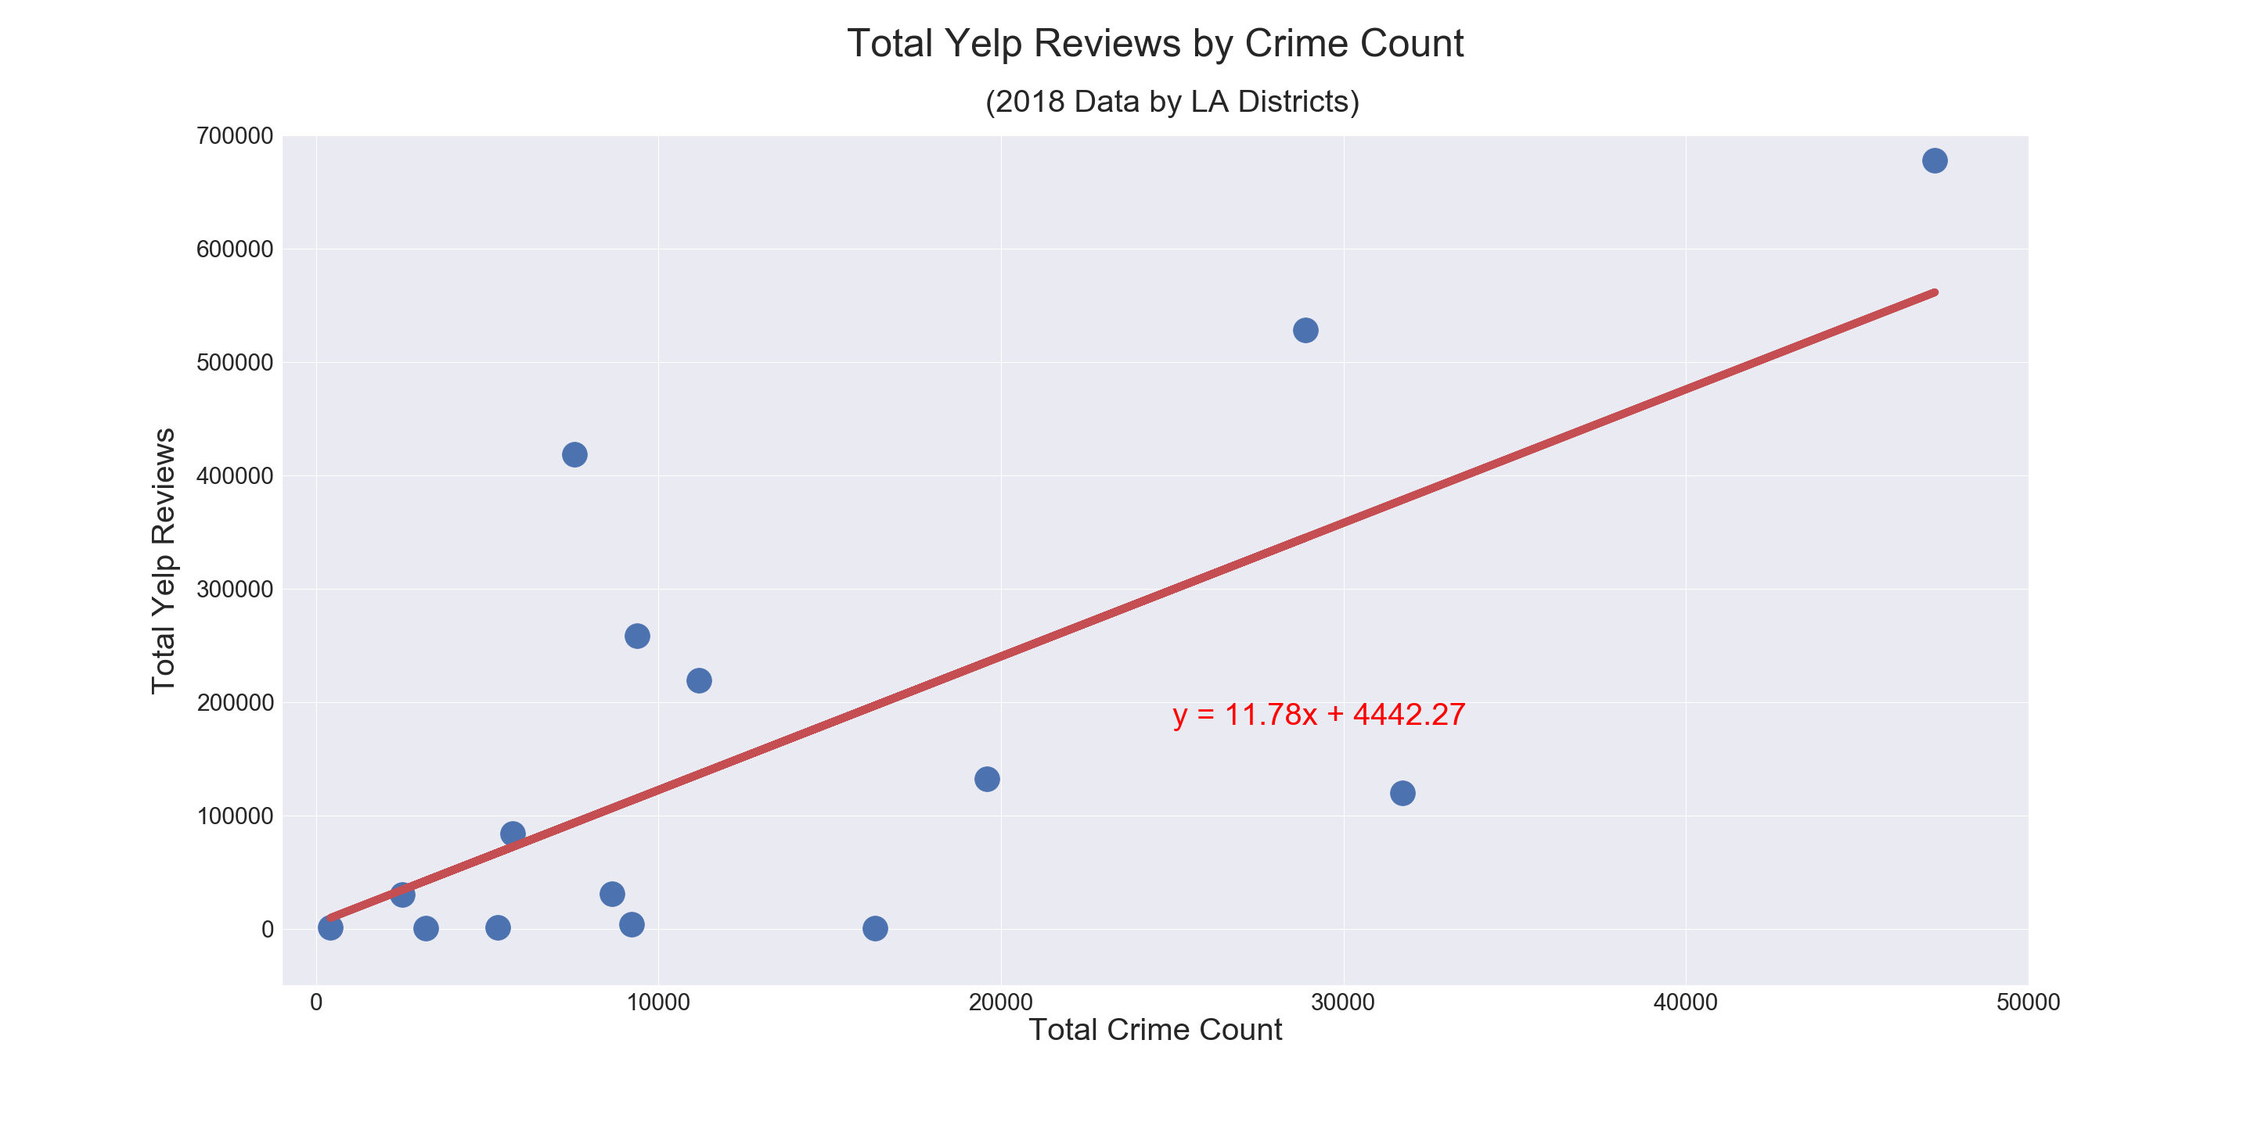

Slide 18
Discussion
We did not find any correlation between either crime or citations and the the yelp rating of a restaurant.
As a result, it seems that these factors have no influence on a restaurant’s yelp rating.
So, when asked “Why does my yelp rating suck?”, the answer is probably “Because your restaurant does.”

Slide 19
Post Mortem: It wasn’t Pretty
There were a lot of problems:
The redistricting code was really irritating
Figuring out how to use github efficiently is an ongoing battle
Finding the right API, library, database for free isn’t always possible, and adapting to more limited scopes or results is imperitive
Yelp limits the radius you can search
How to advance this research in the future:
How to do this same research again, better?
How do these same factors affect other areas, or are affected themselves?

